Slide 1
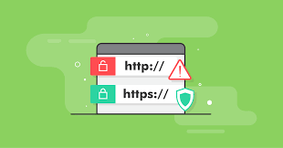
The Added Security of HTTPS
Jackson Crowley, Henry Judkins,
Will King

Slide 2

Overview
We are going to attempt to emulate a real world environment where someone is using a public wireless connection to access an HTTP and HTTPS website while transferring sensitive data over the website.

Slide 3
AGENDA
01
VM Setup
04
The Packet Sniffing
Listing the VM’s
Listing Required Softwares
Using Wireshark
Finding Sensitive info on HTTP
Hidden on HTTPS
02
Network Setup
05
CLOSING
What they look like
How we hosted them
Broad Recap of added security
Questions
Thank You
03
The Websites
PFSense
Network Topology

Slide 4
01
Setting up the VMs

Slide 5
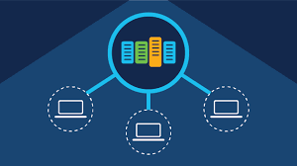
VM 1
VM 1 will host an HTTP Website
They will need to install Python, Flask, Apache, and the website code.
VM 2
VM 2 will host the HTTPS website and will need to install the same things as VM1
VM 3
This vm will be a client browsing the web and doesn’t need to download anything
VM 4
This VM will be the nefarious packet sniffer and will install wireshark
List of VMs
What each VM will do and what software we put on them

Slide 6
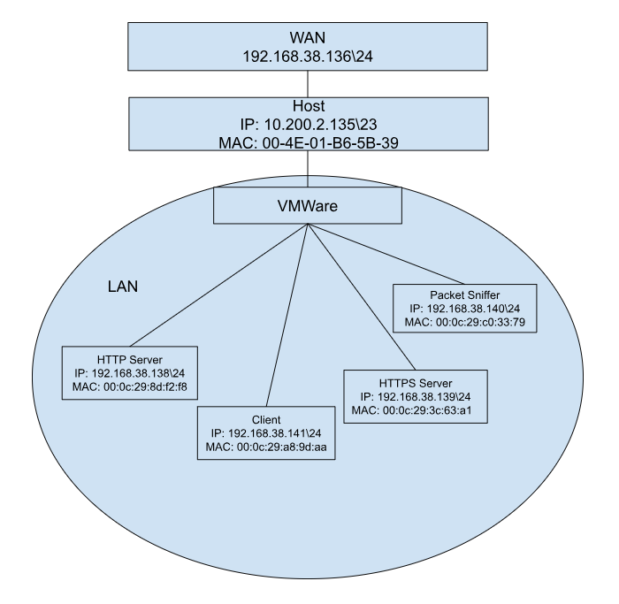
Network Topology Diagram

Slide 7
02
The Websites

Slide 8
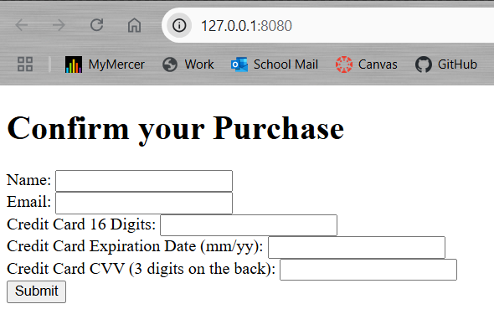
The Website
The websites use the same HTML code for the HTTP and HTTPS Website
We kept it simple and ugly

Slide 9
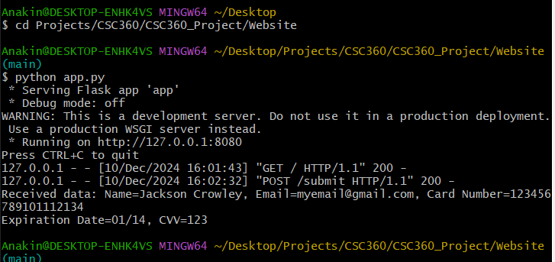
Python Flask
You run it from any terminal
It is lightweight, easy to use, and can deliver user input to the hosting computer

Slide 10
03
Setting up the Servers

Slide 11
Dependencies
sudo apt-get install python3
sudo apt install apache2
sudo apt install python3-flask
sudo apt install libapache2-mod-wsgi-py3
Only for HTTPS
sudo apt install openssl

Slide 12
Setting up an HTTP Server
First we need to set up Apache to use mod-wsgi
sudo a2enmod wsgi
sudo systemctl restart apache2
Next we add the necessary website files to /var/www/html/
The last step is creating an html.conf file in /etc/apache2/sites-enabled/ and a html.wsgi file in /var/www/html/

Slide 13
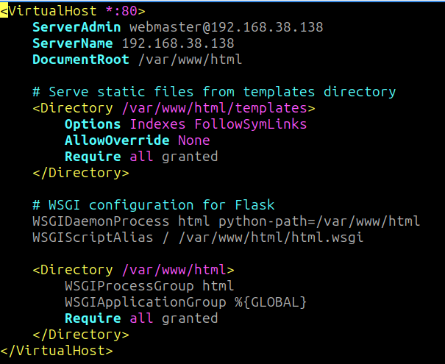
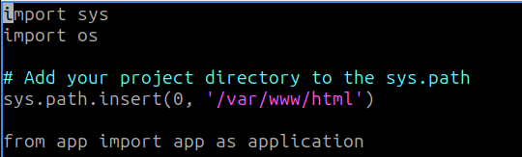
Config Files for HTTP

Slide 14
Setting up an HTTPS Server
In order to do this we follow all of the same steps as we did for the HTTP server with several key differences.
First of all we need to install OpenSSL
sudo apt install openssl
This allows us to self assign an SSL key
sudo openssl req -x509 -nodes -days 365 -newkey rsa:2048 -keyout /etc/ssl/private/apache-selfsigned.key -out /etc/ssl/certs/apache-selfsigned.crt
These keys will be used in the config files in /etc/apache2/sites-enabled

Slide 15
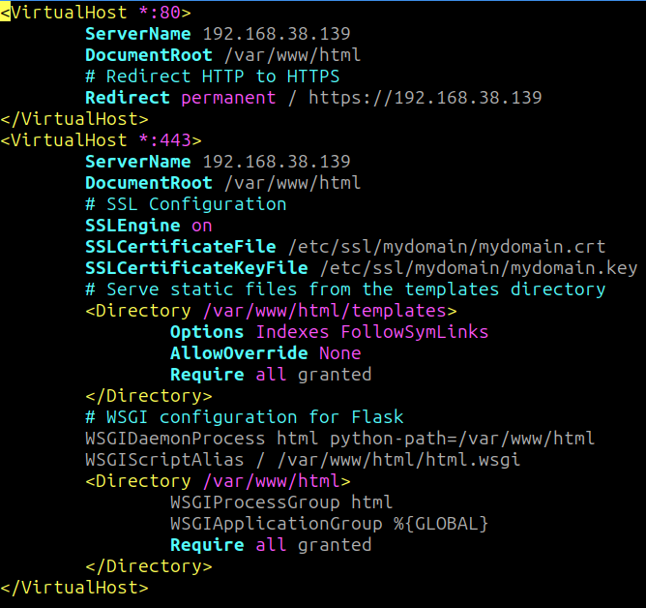
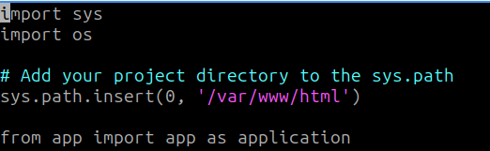
Config Files for HTTPS

Slide 16
04
Action Plan

Slide 17

HTTP Packet Sniffing
HTTP packet sniffing using wireshark is very simple
Start a capture when the user navigates to the website
Once the user inputs data, a POST packet should be sent by the server
By filtering http traffic, a wireshark user can view the hypertext transfer protocol data by clicking on the package, displaying all the important user data as shown.

Slide 18
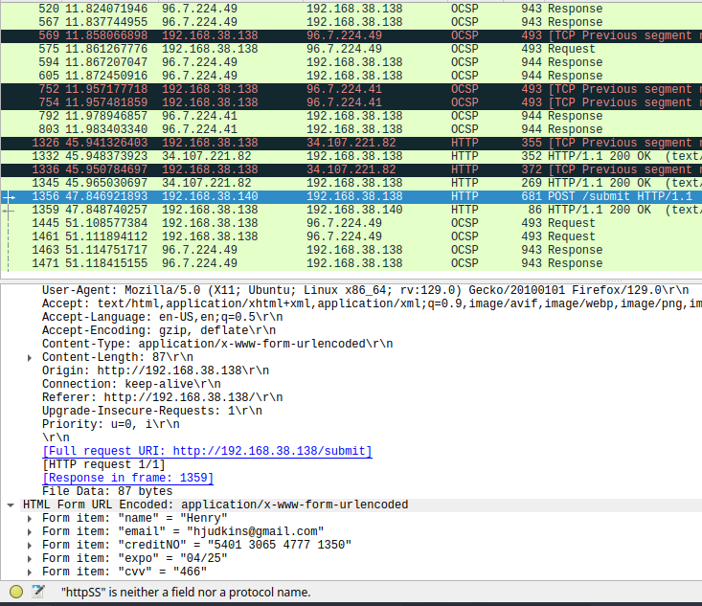
HTTP Packet Information

Slide 19
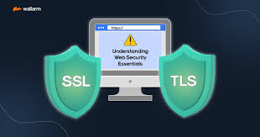
HTTPS Packet Sniffing
HTTPS packet sniffing is much more difficult to do because of TLS encryption.
The TLS handshake verifies the client and shares an encryption key so that only the client and server can decrypt the data.

Slide 20
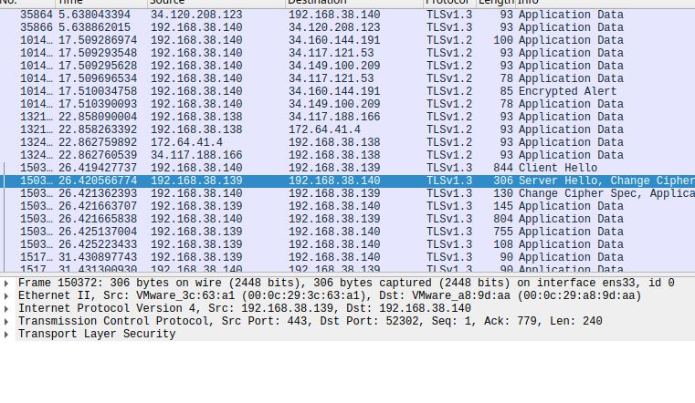
HTTP Packet Information

Slide 21
HTTP vs. HTTPS Packet Sniffing
HTTP
HTTPS
Since there is no encryption, data is available to anyone using a packet sniffer.
TLS encryption secures data so that it cannot be viewed using a regular packet sniffer
However, there are ways to bypass this
The most common way to do so is called a Man-in-the-middle attack (MITM) . This method can take a couple of forms:
SSL Stripping: downgrades an HTTPS connection to HTTP by removing TLS
Certificate Spoofing: An attacker uses a false certificate that the client accepts

Slide 22
05
Closing Remarks

Slide 23
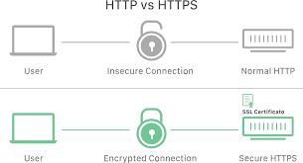
Summary
The goal of this project is to demonstrate the importance of TLS encryption by setting up a real world scenario.
Two websites: http and https
Accessing both and capturing packets using wireshark
Observing packets from http and https
Analyzing differences

Slide 24
THANK YOU
Questions???
https://github.com/anakin124/CSC360_Project/tree/main

